Slide 1

LESSON 3 - JOHN 2:1-25

Slide 2
THEME:
“Therefore many other signs Jesus also performed in the presence of the disciples, which are not written in this book; but these have been written so that you may believe that Jesus is the Christ, the Son of God; and that believing you may have life in His name.”
(John 20:30–31, NASB95)
Notes:
John is a Gospel of Belief, evidence … to sustain the claim that Jesus is the Christ, the Son of God.
John introduced Jesus in Ch. 1, the first 18 verses, …

Slide 3
Introduction of Jesus the Christ:
John the Apostle
(John 1:1-2, 14, 18)
“And the Word became flesh, and dwelt among us, and we saw His glory, glory as of the only begotten from the Father, full of grace and truth.”
(John 1:14, NASB95)
“In the beginning was the Word, and the Word was with God, and the Word was God. He was in the beginning with God.” (John 1:1–2, NASB95)
“No one has seen God at any time; the only begotten God who is in the bosom of the Father, He has explained Him.”
(John 1:18, NASB95)
Notes:
--
That was John’s introduction of Jesus in his prologue.

Slide 4
Introduction of Jesus the Christ:
“This is the testimony of John, when the Jews sent to him priests and Levites from Jerusalem to ask him, “Who are you?” And he confessed and did not deny, but confessed, “I am not the Christ.” They asked him, “What then? Are you Elijah?” And he said, “I am not.” “Are you the Prophet?” And he answered, “No.” Then they said to him, “Who are you, so that we may give an answer to those who sent us? What do you say about yourself?” He said, “I am a voice of one crying in the wilderness, ‘Make straight the way of the Lord,’ as Isaiah the prophet said.””
(John 1:19–23, NASB95)
John the Apostle
(John 1:1-2, 14, 18)
“The next day he saw Jesus coming to him and said, “Behold, the Lamb of God who takes away the sin of the world!”
(John 1:29, NASB95)
John the Baptist
- (Negative: John 1:19-23;
Positive: John 1:29)
Notes:
Then we have John the Baptist’s introduction beginning in vs. 19:
--
vs. 29, speaking to his disciples …
---
John the Baptist’s testimony was that Jesus was the lamb of God, fulfilling Isaiah 53 as the great sacrifice for sin in the world.

Slide 5
Introduction of Jesus the Christ:
“John testified saying, “I have seen the Spirit descending as a dove out of heaven, and He remained upon Him. “I did not recognize Him, but He who sent me to baptize in water said to me, ‘He upon whom you see the Spirit descending and remaining upon Him, this is the One who baptizes in the Holy Spirit.’ “I myself have seen, and have testified that this is the Son of God.””
(John 1:32–34, NASB95)
John the Apostle
(John 1:1-2, 14, 18)
“Again the next day John was standing with two of his disciples, and he looked at Jesus as He walked, and said, “Behold, the Lamb of God!” The two disciples heard him speak, and they followed Jesus.” (John 1:35–37, NASB95)
John the Baptist
- (Negative: John 1:19-23;
Positive: John 1:29)
- Baptism of Jesus (God confirmed)
(John 1:32-34)
Notes:
John the Baptist’s 2nd testimony was about Jesus’ baptism, that he didn’t recognize Him, but God told him …
---
After Jn 1:32-34:
John the Baptist's testimony was that he was the "Lamb of God", he was the "Son of God'. Through him the Holy Spirit would be given. I baptize you with water but this is the One who baptizes in the Holy Spirit (Lk 3:16).
Later on, John the Baptist with two of his disciples said: Jn 1:35-37

Slide 6
Introduction of Jesus the Christ:
John the Apostle
(John 1:1-2, 14, 18)
“One of the two who heard John speak and followed Him, was Andrew, Simon Peter’s brother. He found first his own brother Simon and said to him, “We have found the Messiah” (which translated means Christ).”
(John 1:40–41, NASB95)
John the Baptist
- (Negative: John 1:19-23;
Positive: John 1:29)
- Baptism of Jesus (God confirmed)
(John 1:32-34)
Andrew told Peter
(John 1:40-41)
Notes:
After a short time, Andrew found Peter and said: “We have found the Messiah”

Slide 7
Introduction of Jesus the Christ:
John the Apostle
(John 1:1-2, 14, 18)
“Philip found Nathanael and said to him, “We have found Him of whom Moses in the Law and also the Prophets wrote—Jesus of Nazareth, the son of Joseph.””
(John 1:45, NASB95)
John the Baptist
- (Negative: John 1:19-23;
Positive: John 1:29)
- Baptism of Jesus (God confirmed)
(John 1:32-34)
Andrew told Peter
(John 1:40-41)
Philip told Nathanael
(John 1:45)
Notes:
Jesus called Philip, Philip went to Nathaniel and said …

Slide 8
Introduction of Jesus the Christ:
John the Apostle
(John 1:1-2, 14, 18)
“Nathanael answered Him, “Rabbi, You are the Son of God; You are the King of Israel.””
(John 1:49, NASB95)
John the Baptist
- (Negative: John 1:19-23;
Positive: John 1:29)
- Baptism of Jesus (God confirmed)
(John 1:32-34)
Andrew told Peter
(John 1:40-41)
Philip told Nathanael
(John 1:45)
Nathanael to Jesus
(John 1:49)

Slide 9
Introduction of Jesus the Christ:
Chapter 1:
Chapter 2:
John the Apostle
(John 1:1-2, 14, 18)
Jesus Introduces Himself
- Wedding at Cana (Galilee)
- Cleansing the Temple (Jerusalem)
John the Baptist
- (Negative: John 1:19-23;
Positive: John 1:29)
Chapter 3:
- Baptism of Jesus (God confirmed)
(John 1:32-34)
Jesus Introduces Himself
- The Kingdom of God to Nicodemus
- Jesus in Judea / John’s Last Test.
Andrew told Peter
(John 1:40-41)
Chapter 4:
Philip told Nathanael
(John 1:45)
Jesus Introduces Himself
- The Woman of Samaria (Galilee)
Nathanael to Jesus
(John 1:49)
Notes:
1st 4 chapters are devoted to Jesus introduction.
In chapter 1 we have the testimony of John the Apostle, John the Baptist and 3 disciples: Andrew, Philip, Nathanael.
---
This morning we are looking at Ch 2 – Jesus introduction of Himself.
---
Ch 5 begins a period of intense controversy over who He was, conflict between Him and the Jews.
Very logical book
John develops his introduction, then enters into the period of controversy then His final speech to the apostles, then His trials and crucifixion.
John is introducing Jesus as the Son of God, offering evidence that he is the Christ the Son of God of whom they have been looking. Very strong book of evidence in the NT.

Slide 10
JOHN 2:1-12

Slide 11
John 2:1 (NASB95)
¹ On the third day there was a wedding in Cana of Galilee, and the mother of Jesus was there;
Probably few days after
calling Philip (1:43-44)
Mother of Jesus mentioned
twice: here and the cross
(19:25ff.) alluded to in 6:42
Notes:
Jesus invited Philip to follow him (1:43‑44). Many believe, therefore, that the wedding in Cana of Galilee was on the third day after Jesus called Phillip. - Harkrider.

Slide 12
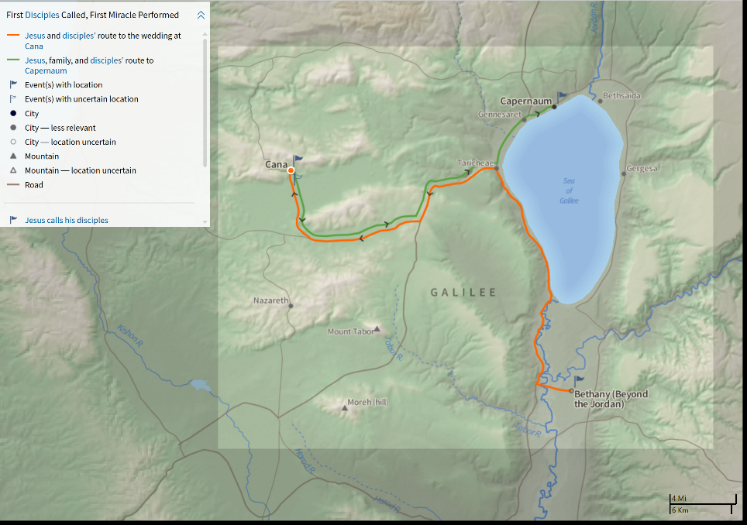
Notes:
Bethany (1:28) to Cana … probably a two day journey.
Cana Approx. 9 miles north of Nazareth.
Cana to Capernaum … vs. 12 … Capernaum is approx. 16 miles ENE of Cana

Slide 13
John 2:2–3 (NASB95)
² and both Jesus and His disciples were invited to the wedding. ³ When the wine ran out, the mother of Jesus said to Him, “They have no wine.”
Jesus places importance on marriage … parables on the kingdom
Unknown who was married
Jewish custom – rights at
brides home then wedding
party moved to permanent
residence
““Then the kingdom of heaven will be comparable to ten virgins, who took their lamps and went out to meet the bridegroom.” (Matthew 25:1, NASB95)
Occasion in some instances lasted up to a week
““The kingdom of heaven may be compared to a king who gave a wedding feast for his son.”
(Matthew 22:2, NASB95)
Serious damage to the reputation of the host
Seems Mary had some responsibility
Notes:
Bob references the parable of the 10 virgins - Matt. 25:1-13 (5 wise / 5 foolish)
In Revelation 19: 7-9:
““Let us rejoice and be glad and give the glory to Him, for the marriage of the Lamb has come and His bride has made herself ready.” It was given to her to clothe herself in fine linen, bright and clean; for the fine linen is the righteous acts of the saints. Then he said to me, “Write, ‘Blessed are those who are invited to the marriage supper of the Lamb.’ ” And he said to me, “These are true words of God.”” (Revelation 19:7–9, NASB95)
Betrothed now to Jesus and married to Jesus when he comes back. Take up our home keeping for eternity.

Slide 14
John 2:4-5 (NASB95)
⁴ And Jesus said to her, “Woman, what does that have to do with us? My hour has not yet come.” ⁵ His mother said to the servants, “Whatever He says to you, do it.”
No disrespect is intended … same term used at the cross (19:26)
“My hour” usually refers to the time when Christ would be crucified (cf. 7:6,8,30; 8:20; 13:1; 17:1)
Seems here He is saying He would determine the proper time to manifest His glory through miracles
“So they were seeking to seize Him; and no man laid his hand on Him, because His hour had not yet come.” (John 7:30, NASB95)
“Jesus spoke these things; and lifting up His eyes to heaven, He said, “Father, the hour has come; glorify Your Son, that the Son may glorify You,”
(John 17:1, NASB95)
“When Jesus then saw His mother, and the disciple whom He loved standing nearby, He said to His mother, “Woman, behold, your son!””
(John 19:26, NASB95)
Mary knew she could rely on Jesus to resolve the problem
Notes:
He would not be disrespectful to his mother ... any idea to insinuate this would be wrong.
John 7 – Jesus teaches at the feast of the Jews, the feast of Booths

Slide 15
Luke 2:41–51 (NASB95)
⁴¹ Now His parents went to Jerusalem every year at the Feast of the Passover. ⁴² And when He became twelve, they went up there according to the custom of the Feast; ⁴³ and as they were returning, after spending the full number of days, the boy Jesus stayed behind in Jerusalem. But His parents were unaware of it… ⁴⁵ When they did not find Him, they returned to Jerusalem looking for Him. ⁴⁶ Then, after three days they found Him in the temple, sitting in the midst of the teachers, both listening to them and asking them
questions…
Luke 2:15–19 (NASB95)
¹⁵ When the angels had gone … the shepherds began saying to one another, “Let us go straight to Bethlehem then, and see this thing that has happened which the Lord has made known to us.” ¹⁶ So they came in a hurry and found their way to Mary and Joseph, and the baby as He lay in the manger. ¹⁷ When they had seen this, they made known the statement which had been told them about this Child. ¹⁸ And all who heard it wondered at the things which were told them by the shepherds. ¹⁹ But Mary treasured all these things,
pondering them in her heart.
Luke 1:26–35 (NASB95)
²⁶ … the angel Gabriel was sent from God to a city in Galilee called Nazareth, ²⁷ to a virgin … and the virgin’s name was Mary… ³⁰ The angel said to her, … “And behold, you will conceive in your womb and bear a son, and you shall name Him Jesus. ³² “He will be great and will be called the Son of the Most High; and the Lord God will give Him the throne of His father David; ³³ and He will reign over the house of Jacob forever, and His kingdom will have no end.”
What did Mary know?
Luke 2:7–12 (NASB95)
⁷ And she gave birth to her firstborn son; … ⁸ In the same region there were some shepherds ... ⁹ And an angel of the Lord suddenly stood before them, and the glory of the Lord shone around them; and they were terribly frightened. ¹⁰ But the angel said to them, “Do not be afraid; for behold, I bring you good news of great joy which will be for all the people; ¹¹ for today in the city of David there has been born for you a Savior, who is Christ the Lord. ¹² “This will be a sign for you: you will find a baby wrapped in cloths and
lying in a manger.”
Luke 2:41–51 (NASB95)
⁴⁸ When they saw Him, they were astonished; and His mother said to Him, “Son, why have You treated us this way? Behold, Your father and I have been anxiously looking for You.” ⁴⁹ And He said to them, “Why is it that you were looking for Me? Did you not know that I had to be in My Father’s house?” ⁵⁰ But they did not understand the statement which He had made to them. ⁵¹ And He went down with them and came to Nazareth, and He continued in subjection to them; and His mother treasured all these things in
her heart.
Divine conception … He was the Son of God
Luke 1:26–35 (NASB95)
³⁴Mary said to the angel, “How can this be, since I am a virgin?” ³⁵ The angel answered and said to her, “The Holy Spirit will come upon you, and the power of the Most High will overshadow you; and for that reason the holy Child shall be called the Son of God.
She treasured things, pondering in her heart
He was here to do His Father’s business
She had the law (Lk 4:16-21)
A time would come when she would turn from looking at him as a son to her Lord and Savior
Her testimony was given at the cross. If He was NOT Divine, she could have stated the facts.

Slide 16
John 2:6-8 (NASB95)
⁶ Now there were six stone waterpots set there for the Jewish custom of purification, containing twenty or thirty gallons each. ⁷ Jesus said to them, “Fill the waterpots with water.” So they filled them up to the brim. ⁸ And He said to them, “Draw some out now and take it to the headwaiter.” So they took it to him.
Jewish custom of purification (Mk 7:3-4)
120 – 180 gallons of water
“(For the Pharisees and all the Jews do not eat unless they carefully wash their hands, thus observing the traditions of the elders; and when they come from the market place, they do not eat unless they cleanse themselves; and there are many other things which they have received in order to observe, such as the washing of cups and pitchers and copper pots.)” (Mark 7:3–4, NASB95)
Notes:
120-180 gallons
Mk 7 – Following tradition - “and had seen that some of His disciples were eating their bread with impure hands, that is, unwashed.” (Mark 7:2, NASB95)

Slide 17
John 2:9–10 (NASB95)
⁹ When the headwaiter tasted the water which had become wine, and did not know where it came from (but the servants who had drawn the water knew), the headwaiter called the bridegroom, ¹⁰ and said to him, “Every man serves the good wine first, and when the people have drunk freely, then he serves the poorer wine; but you have kept the good wine until now.”
“did not know where it came from”
Headwaiter recognized this was the best wine!
Order was reversed, usually serve the good first
“drunk freely”

Slide 18
John 2:11 (NASB95)
¹¹ This beginning of His signs Jesus did in Cana of Galilee, and manifested His glory, and His disciples believed in Him.
Signs – authenticated who Jesus was (John 4:48)
God’s Testimony
- Miracles = Supernatural,
Divine Power
- Wonders = Amazement
- Signs = Confirmation of
a claim
“And the Word became flesh, and dwelt among us, and we saw His glory, glory as of the only begotten from the Father, full of grace and truth.”
(John 1:14, NASB95)
““Men of Israel, listen to these words: Jesus the Nazarene, a man attested to you by God with miracles and wonders and signs which God performed through Him in your midst, just as you yourselves know—” (Acts 2:22, NASB95)
His glory:
- The only begotten from
the Father
“So Jesus said to him, “Unless you people see signs and wonders, you simply will not believe.”” (John 4:48, NASB95)
Result:
- His disciples believed
Notes:
Miracle = supernatural powers from God
produced
Wonders = Amazement in the heart of the observer
which served as
Signs = signified / pointed to who He was
Sign pointed away from itself to the one who performed it!
Who was the bridegroom? We do not know. Who was the bride? We are not told. In exactly what relation did Mary stand to the wedded pair: was she, perhaps, the aunt of bride or groom? Silence again. Did Nathaniel serve as “best man” (friend of the bridegroom)? Also on this score our curiosity receives no satisfaction whatever. In the full light of day stands the Christ. All the rest is shadow
Hendriksen, W., & Kistemaker, S. J. (19532001). Exposition of the Gospel According to John (Vol. 1, pp. 117118). Grand Rapids: Baker Book House.
Hendriksen, W., & Kistemaker, S. J. (1953–2001). Exposition of the Gospel According to John (Vol. 1, pp. 117–118). Grand Rapids: Baker Book House.

Slide 19
Looking Back:
Who was the bridegroom?
Who was the bride?
What part did Mary have in the wedding?
In the full light of day stands the Christ.
All the rest is a shadow.
Notes:
Miracle = supernatural powers from God
produced
Wonders = Amazement in the heart of the observer
which served as
Signs = signified / pointed to who He was
Sign pointed away from itself to the one who performed it!
Who was the bridegroom? We do not know. Who was the bride? We are not told. In exactly what relation did Mary stand to the wedded pair: was she, perhaps, the aunt of bride or groom? Silence again. Did Nathaniel serve as “best man” (friend of the bridegroom)? Also on this score our curiosity receives no satisfaction whatever. In the full light of day stands the Christ. All the rest is shadow
Hendriksen, W., & Kistemaker, S. J. (19532001). Exposition of the Gospel According to John (Vol. 1, pp. 117118). Grand Rapids: Baker Book House.
Hendriksen, W., & Kistemaker, S. J. (1953–2001). Exposition of the Gospel According to John (Vol. 1, pp. 117–118). Grand Rapids: Baker Book House.

Slide 20
Application:
Jesus is Lord of creation / transposing power
Jesus provided quality, in abundance
Mary had confidence in Jesus in time of need
“In the beginning was the Word, and the Word was with God, and the Word was God. He was in the beginning with God. All things came into being through Him, and apart from Him nothing came into being that has come into being.”
(John 1:1–3, NASB95)
“For of His fullness we have all received, and grace upon grace. For the Law was given through Moses; grace and truth were realized through Jesus Christ.”
(John 1:16–17, NASB95)
In the full light of day stands the Christ.
All the rest is a shadow.
Notes:
1 – Jesus turned the water into wine, bypassing the natural creation process.
2 – When Jesus does something, he produces the highest quality and does it abundantly.
3 – Mary had full confidence … just as we should today, casting our cares on him … as our Lord and Savior.

Slide 21
“If Jesus produced
120-160 gallons of alcohol at Cana, He obviously approves of alcohol in moderation.”
“If wine was good enough for Jesus, it is good enough for me!”

Slide 22
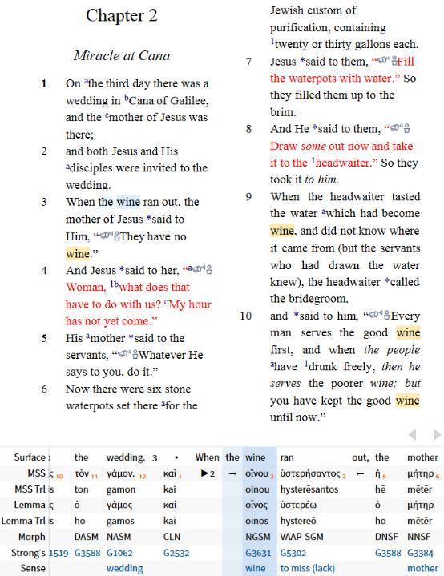
oinos = wine

Slide 23
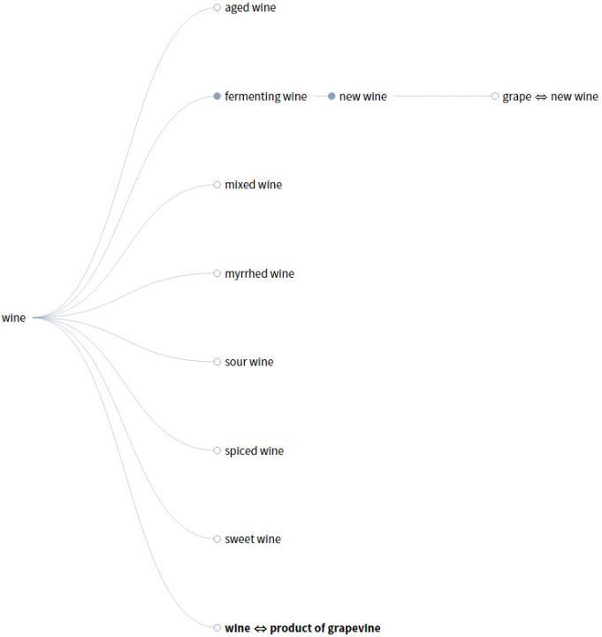
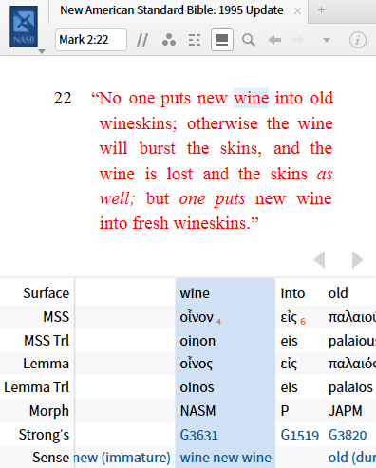
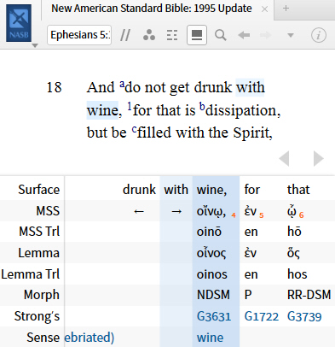
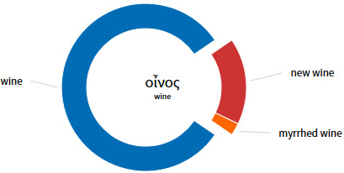
oinos – a generic term, a production of the vine, both unfermented and fermented
Example:
Unfermented: Mk 2:22
Fermented: Eph 5:18

Slide 24
oinos – a generic term, a production of the vine, both unfermented and fermented
“… in the Roman world of New Testament times … the best wines were those whose alcoholic potency had been removed by boiling or filtration. Pliny, for example, says that “wines are most beneficial (utilissimum) when all their potency has been removed by the strainer.” Similarly, Plutarch points out that wine is “much more pleasant to drink” when it “neither inflames the brain nor infests the mind or passions” because its strength has been removed through frequent filtering.”
Bacchiocchi, Samuele (2014-03-30). Wine in the Bible: A Biblical Study on the Use of Alcoholic Beverages. Biblical Perspectives. Kindle Edition.
What was “The good wine”?
John 2:10 (NASB95)
¹⁰ and said to him, “Every man serves the good wine first, and when the people have drunk freely, then he serves the poorer wine...”
“High quality alcohol, right?”
Notes:
Culture
Pliny – Historians, Philosopher AD 23-79 or 61-113
Plutarch – Historians AD 46-120
Lived within 50-90 yrs. of Christ

Slide 25
oinos – a generic term, a production of the vine, both unfermented and fermented
Barnes Notes:
Pliny, Plutarch, and Horace describe wine as "good," or mention that as "the best wine," which was harmless or "innocent" …" The most useful wine … was that which had little strength; and the most wholesome wine … was that which had not been adulterated by "the addition of anything to the 'must' or juice." Pliny expressly says that a good wine was one that was destitute of spirit (lib. iv. c. 13). It should not be assumed, therefore, that the "good wine" was "stronger" than the other: it is rather to be presumed that it was milder.
The wine referred to here was doubtless such as was commonly drunk in Palestine. That was the pure juice of the grape.
http://www.sacred-texts.com/bib/cmt/barnes/joh002.htm
What was “The good wine”?
John 2:10 (NASB95)
¹⁰ and said to him, “Every man serves the good wine first, and when the people have drunk freely, then he serves the poorer wine...”
Notes:
Based on the culture …

Slide 26
oinos – a generic term, a production of the vine, both unfermented and fermented
“Now the deeds of the flesh are evident, which are: … envying, drunkenness, carousing, and things like these, of which I forewarn you, just as I have forewarned you, that those who practice such things will not inherit the kingdom of God.”
(Galatians 5:19–21, NASB95)
“Therefore, since Christ has suffered in the flesh, arm yourselves also with the same purpose, because he who has suffered in the flesh has ceased from sin, so as to live the rest of the time in the flesh no longer for the lusts of men, but for the will of God. For the time already past is sufficient for you to have carried out the desire of the Gentiles, having pursued a course of sensuality, lusts, drunkenness, carousing, drinking parties and abominable idolatries.”
(1 Peter 4:1–3, NASB95)
“Wine is a mocker, strong drink a brawler, And whoever is intoxicated by it is not wise.”
(Proverbs 20:1, NASB95)
What was “The good wine”?
Moral Implications
Scripture Condemnation –
Prov 20:1; Gal 5:21; 1 Pet 4:1-3

Slide 27
oinos – a generic term, a production of the vine, both unfermented and fermented
“for the Son of Man did not come to destroy men’s lives, but to save them.” … (Luke 9:56, NASB95)
What was “The good wine”?
“The next day he saw Jesus coming to him and said, “Behold, the Lamb of God who takes away the sin of the world!”
(John 1:29, NASB95)
Moral Implications
Scripture Condemnation –
Prov 20:1; Gal 5:21; 1 Pet 4:1-3
Purpose of Jesus –
Luke 9:56
Notes:
“who committed no sin, nor was any deceit found in His mouth;” (1 Peter 2:22, NASB95)
“knowing that you were not redeemed with perishable things like silver or gold from your futile way of life inherited from your forefathers, but with precious blood, as of a lamb unblemished and spotless, the blood of Christ.” (1 Peter 1:18–19, NASB95)
If Jesus produced 120-180 additional gallons of alcohol after the people had drunk freely … he could not be considered sinless as he aided in their intoxication.

Slide 28
oinos – a generic term, a production of the vine, both unfermented and fermented
Options:
1. Jesus approves of excessive alcoholic drinking
What was “The good wine”?
2. The wine (oinos) was grape juice
Moral Implications
Scripture Condemnation –
Prov 20:1; Gal 5:21; 1 Pet 4:1-3
Purpose of Jesus –
Luke 9:56
Conclusion
Notes:
Stumbling Block verses:
1 Cor. 8:9; 9:12; 10:23, 24, 32, 33
“But take care that this liberty of yours does not somehow become a stumbling block to the weak.” (1 Corinthians 8:9, NASB95)
“If others share the right over you, do we not more? Nevertheless, we did not use this right, but we endure all things so that we will cause no hindrance to the gospel of Christ.” (1 Corinthians 9:12, NASB95)
“All things are lawful, but not all things are profitable. All things are lawful, but not all things edify.” (1 Corinthians 10:23, NASB95)
“Let no one seek his own good, but that of his neighbor.” (1 Corinthians 10:24, NASB95)
“Give no offense either to Jews or to Greeks or to the church of God;” (1 Corinthians 10:32, NASB95)
“just as I also please all men in all things, not seeking my own profit but the profit of the many, so that they may be saved.” (1 Corinthians 10:33, NASB95)

Slide 29
John 2:12 (NASB95)
¹² After this He went down to Capernaum, He and His mother and His brothers and His disciples; and they stayed there a few days.
His mother, His brothers (James, Joses, Jude, and Simon, Mark 6:3; Matt. 13:55-56), and His disciples went with Him.
Jesus spent much of His time in Capernaum during the three years of His public ministry (cf. Matt. 11:23).

Slide 30
Notes:
Bethany (1:28) to Cana … probably a two day journey.
Cana Approx. 9 miles north of Nazareth.
Cana to Capernaum … vs. 12 … Capernaum is approx. 16 miles ENE of Cana

Slide 31


Slide 32

John 2:13 (NASB95)
¹³ The Passover of the Jews was near, and Jesus went up to Jerusalem.
Not the same occurrence as Mt 21, Mk 11, Lk 19
Public Ministry ≈ 3 yrs.
- Four Passover Feasts:
1st – Here, AD 27 or 28
2nd - (5:1) – Feast of the Jews
3rd - (6:4)
4th - (12:1; 13:1; 19:14)
Notes:
Exodus 12-13 – Passover
The day on which the lamb was killed was followed by the seven-day Feast of Unleavened Bread, celebrated from the fifteenth to the twenty-first of Nisan.
Every male Jew, from the age of twelve and up, was expected to attend the Passover at Jerusalem, a feast celebrated to commemorate the deliverance of the people of Israel from Egyptian bondage. On the tenth of the month Abib or Nisan (which generally corresponds to our March, though its closing days sometimes extend into our April) a male lamb, of the first year, without blemish, was taken, and on the fourteenth day, between three and six o’clock in the afternoon, it was killed.

Slide 33
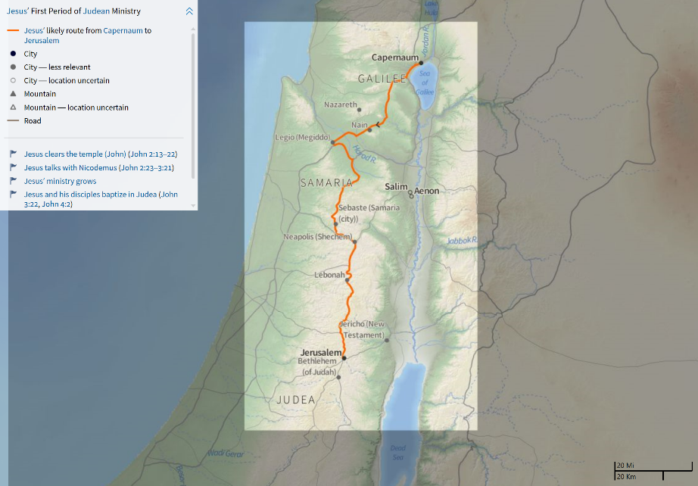
Notes:
Approximately 85 miles from Capernaum to Jerusalem.

Slide 34
John 2:14 (NASB95)
¹⁴ And He found in the temple those who were selling oxen and sheep and doves, and the money changers seated at their tables.
Various sacrifices had to be made during Passover / Feast of Unleavened Bread
(Num 28:16-25)
Custom for faithful Jews to travel from all points of the known world “to present themselves before the Lord” (Deut. 16:5-8)
Numbers 28:16–19 (NASB95)
¹⁶ ‘Then on the fourteenth day of the first month shall be the Lord’s Passover. ¹⁷ ‘On the fifteenth day of this month shall be a feast, unleavened bread shall be eaten for seven days. ¹⁸ ‘On the first day shall be a holy convocation; you shall do no laborious work. ¹⁹ ‘You shall present an offering by fire, a burnt offering to the Lord: two bulls and one ram and seven male lambs one year old, having them without defect. …
Josephus tells us that in one year in the days of Cestius, 256,000 lambs were slaughtered and that at least 10 men were counted to each (≈ 2.5M men) (Truth Commentary – King)
½ shekel temple tax was paid by conscientious Jewish males 20 and over with Jewish coin (Mt 17:27)
Idea was to provide a needed service
Notes:
Temple Tax – Mt. 17:27 – Jesus & Peter paid tax with a shekel from a fishes mouth.

Slide 35
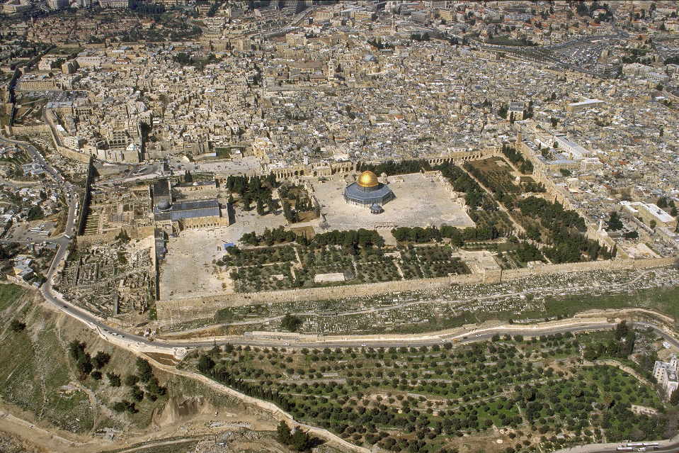
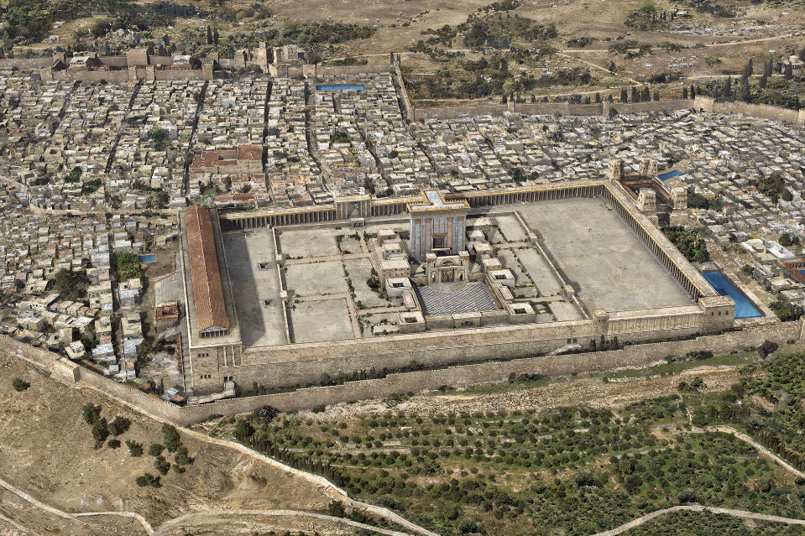
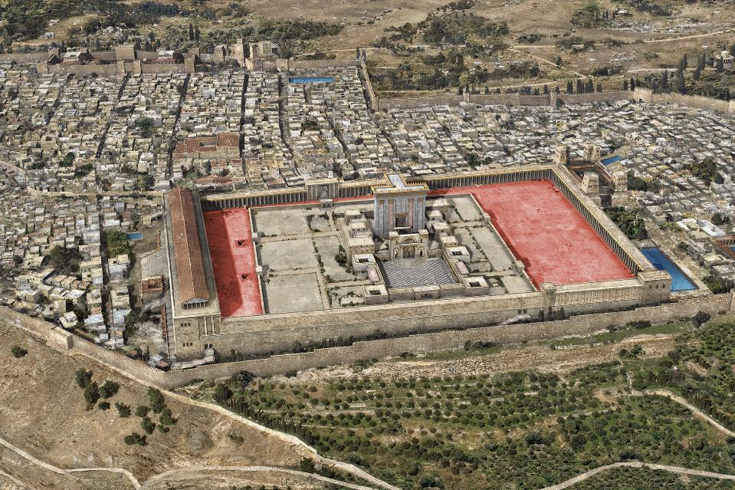
Herod’s Temple - Gentiles’ / Outer Court
Herod’s Temple (Reconstruction)
Jerusalem Today (2014)
Notes:
Herod’s Temple

Slide 36
John 2:15-17 (NASB95)
¹⁵ And He made a scourge of cords, and drove them all out of the temple, with the sheep and the oxen; and He poured out the coins of the money changers and overturned their tables; ¹⁶ and to those who were selling the doves He said, “Take these things away; stop making My Father’s house a place of business.” ¹⁷ His disciples remembered that it was written, “Zeal for Your house will consume me.”
Turned into corrupt business practice with high exchange fees
The business was in the wrong location! This was a place for Gentiles to offer prayer to God!
Jesus showed righteous indignation (outrage) over sin!
“And He began to teach and say to them, “Is it not written, ‘My house shall be called a house of prayer for all the nations’? But you have made it a robbers’ den. ^{(ISA 56:7)}””
(Mark 11:17, NASB95)
Disciples remembered Ps. 69:9
What are the consequences if we are NOT zealous for righteousness?
Is there a time for the Christian to show this same zeal for righteousness?
Jesus was wholly concerned with righteousness … not making friends with the Jewish Elite
Notes:
Mark 11:17 is a quotation from Isa 56:7
Court of the gentiles, God made provision that the gentiles were to come up to his temple, that was back at Solomon's temple that was set when Solomon built the temple in the dedication. This was a place the nation, the foreigner could come and offer his prayers unto Jehovah.
“Be angry, and yet do not sin; do not let the sun go down on your anger,” (Ephesians 4:26, NASB95)

Slide 37
John 2:18–19 (NASB95)
¹⁸ The Jews then said to Him, “What sign do You show us as your authority for doing these things?” ¹⁹ Jesus answered them, “Destroy this temple, and in three days I will raise it up.”
Show us proof! One of several times (Mt 12:38f.; 16:1-4; Mk 8:11-13;
Lk 11:16, 29)
Jesus performed many signs but they accepted none of them! (v. 23)
Ultimate proof = Death, Burial and Resurrection
Romans 1:3–4 (NASB95)
³ concerning His Son, who was born of a descendant of David according to the flesh, ⁴ who was declared the Son of God with power by the resurrection from the dead, according to the Spirit of holiness, Jesus Christ our Lord,
Notes:
Different occasion:
Matthew 12:38–40 (NASB95)
³⁸ Then some of the scribes and Pharisees said to Him, “Teacher, we want to see a sign from You.” ³⁹ But He answered and said to them, “An evil and adulterous generation craves for a sign; and yet no sign will be given to it but the sign of Jonah the prophet; ⁴⁰ for just as Jonah was three days and three nights in the belly of the sea monster, so will the Son of Man be three days and three nights in the heart of the earth.
John 10:17–18 (NASB95)
¹⁷ “For this reason the Father loves Me, because I lay down My life so that I may take it again. ¹⁸ “No one has taken it away from Me, but I lay it down on My own initiative. I have authority to lay it down, and I have authority to take it up again. This commandment I received from My Father.”

Slide 38
John 2:20-21 (NASB95)
²⁰ The Jews then said, “It took forty-six years to build this temple, and will You raise it up in three days?” ²¹ But He was speaking of the temple of His body.
They didn’t understand … due to a hardened heart
Jesus explanation of why he spoke in parables seems to apply here
(Mt 13:13-15)
Attitude continued to the cross
Matthew 13:13–15 (NASB95)
¹³ “Therefore I speak to them in parables; because while seeing they do not see, and while hearing they do not hear, nor do they understand. ¹⁴ “In their case the prophecy of Isaiah is being fulfilled, which says, ‘You will keep on hearing, but will not understand; You will keep on seeing, but will not perceive; ¹⁵ For the heart of this people has become dull, With their ears they scarcely hear, And they have closed their eyes, Otherwise they would see with their eyes, Hear with their ears, And understand with their heart
and return, And I would heal them. ^{(ISA 6:9-10)}’
We will see this pattern over and over in John:
- A saying of Jesus
- A complete
misunderstanding
- An explanation
(3.3ff.; 4:10ff., 32ff.;
6:41ff., 51ff.; 11:11ff.;
14:7ff.)
Matthew 27:39–42 (NASB95)
³⁹ And those passing by were hurling abuse at Him, wagging their heads ⁴⁰ and saying, “You who are going to destroy the temple and rebuild it in three days, save Yourself! If You are the Son of God, come down from the cross.” ⁴¹ In the same way the chief priests also, along with the scribes and elders, were mocking Him and saying, ⁴² “He saved others; He cannot save Himself. He is the King of Israel; let Him now come down from the cross, and we will believe in Him.

Slide 39
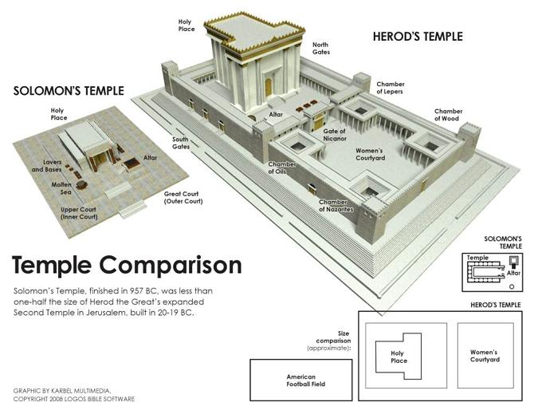
Literal Temple: Page 14
Original – Solomon ≈ 1000 BC
Destroyed by Babylonians ≈ 586 BC (Jer. 52:12-14)
Rebuilt 70 yrs. later, not same dimensions and glory as the 1st (Ezra 3:11-13)
Herod’s Temple
Began in
20/19 BC
Work still in progress here, AD 27/28
(≈ 46 years)
Completed in
63 AD, ≈ 7 yrs. before it was destroyed by Titus
Notes:
1 Kgs 5, 8; 2 Chron. 6

Slide 40
John 2:22 (NASB95)
²² So when He was raised from the dead, His disciples remembered that He said this; and they believed the Scripture and the word which Jesus had spoken.
Lk 24 - At the tomb and on the way to Emmaus
Holy Spirit
They “believed the Scripture and the word which Jesus had spoken.”
Luke 24:8 (NASB95)
⁸ And they remembered His words,
Luke 24:45–46 (NASB95)
⁴⁵ Then He opened their minds to understand the Scriptures, ⁴⁶ and He said to them, “Thus it is written, that the Christ would suffer and rise again from the dead the third day,
John 14:26 (NASB95)
²⁶ “But the Helper, the Holy Spirit, whom the Father will send in My name, He will teach you all things, and bring to your remembrance all that I said to you.
Notes:
John 10:30 (NASB95) - ³⁰ “I and the Father are one.”
John 10:17–18 (NASB95)
¹⁷ “For this reason the Father loves Me, because I lay down My life so that I may take it again. ¹⁸ “No one has taken it away from Me, but I lay it down on My own initiative. I have authority to lay it down, and I have authority to take it up again. This commandment I received from My Father.”

Slide 41
John 2:23–25 (NASB95)
²³ Now when He was in Jerusalem at the Passover, during the feast, many believed in His name, observing His signs which He was doing. ²⁴ But Jesus, on His part, was not entrusting Himself to them, for He knew all men, ²⁵ and because He did not need anyone to testify concerning man, for He Himself knew what was in man.
Signs – authenticated who Jesus was (John 4:48)
Result:
- Many Believed
Jesus knows the hearts / minds of men as we have seen…
John 20:30–31 (NASB95)
³⁰ Therefore many other signs Jesus also performed in the presence of the disciples, which are not written in this book; ³¹ but these have been written so that you may believe that Jesus is the Christ, the Son of God; and that believing you may have life in His name.
There is a difference in superficial faith and penetrating faith
John 1:43 (NASB95)
⁴³ The next day He purposed to go into Galilee, and He found Philip. And Jesus said to him, “Follow Me.”
John 1:47 (NASB95)
⁴⁷ Jesus saw Nathanael coming to Him, and said of him, “Behold, an Israelite indeed, in whom there is no deceit!”
John 6:26 (NASB95)
²⁶ Jesus answered them and said, “Truly, truly, I say to you, you seek Me, not because you saw signs, but because you ate of the loaves and were filled.

Slide 42
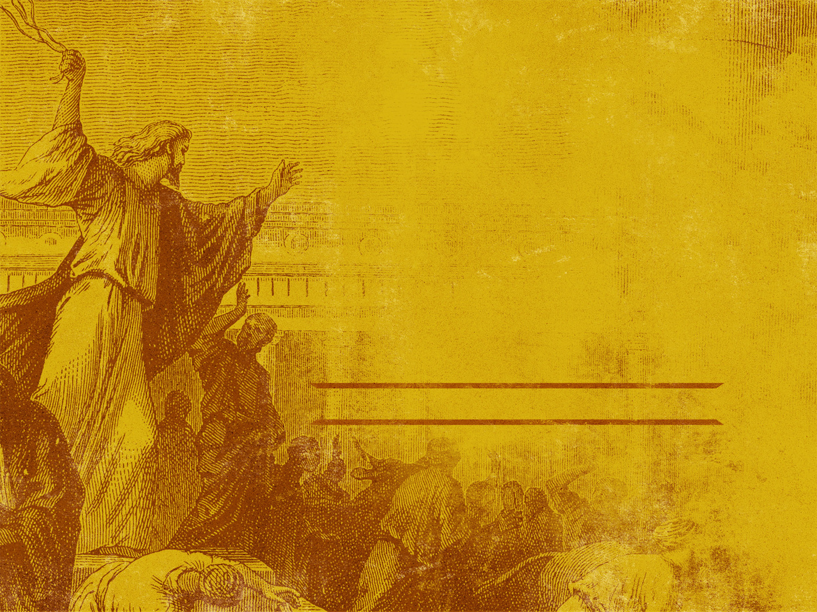
Application:
If Jesus literally, in the flesh, were here today:
Would He be indignant with our worship?
Would He be indignant
with me?
“Or do you not know that your body is a temple of the Holy Spirit who is in you, whom you have from God, and that you are not your own? For you have been bought with a price: therefore glorify God in your body.”
(1 Corinthians 6:19–20, NASB95)
““God is spirit, and those who worship Him must worship in spirit and truth.””
(John 4:24, NASB95)
Notes:
Our salvation depends on worshipping in Spirit and Truth and our individual hearts being focused on him! Can we say “Christ lives in me?”
““God is spirit, and those who worship Him must worship in spirit and truth.”” (John 4:24, NASB95)
“Or do you not know that your body is a temple of the Holy Spirit who is in you, whom you have from God, and that you are not your own? For you have been bought with a price: therefore glorify God in your body.” (1 Corinthians 6:19–20, NASB95)

Slide 43
LESSON 3 - JOHN 2:1-25

Slide 44
